Slide 1

MAJOR PROJECT - COHORT 04
IoT-Driven Cold Chain System
Real-Time Monitoring and Predictive Failure Prevention for Temperature-Sensitive Logistics
Krithi | Harsha Vardhan S | Ananya C
Vijetha | P Krishna Vamsi | Durga Prasad S
Sachidananda M M | Ramitha R | Nagaraju M
Hadiya Khan | C Pavitra | Charan B S
S Vidya Shree | Abhinav P | Sachin Murchavar

Slide 2
PROJECT FRAMEWORK
Context, Motivation, and Objective

Slide 3


CONTEXT & MOTIVATION
Global Necessity
Preventive Gap
Rising demand for vaccine distribution and perishable goods logistics requires environmental control to prevent multi-million dollar losses.
Traditional systems are reactive. Our motivation is to integrate predictive analytics to mitigate risks before spoilage occurs.
Human Error
Scalability
Manual monitoring is prone to oversight. Automation ensures continuous compliance with WHO 2-8°C norms.
The need for cost-effective, IoT-enabled solutions that can be deployed across vast logistical networks with ease.

Slide 4
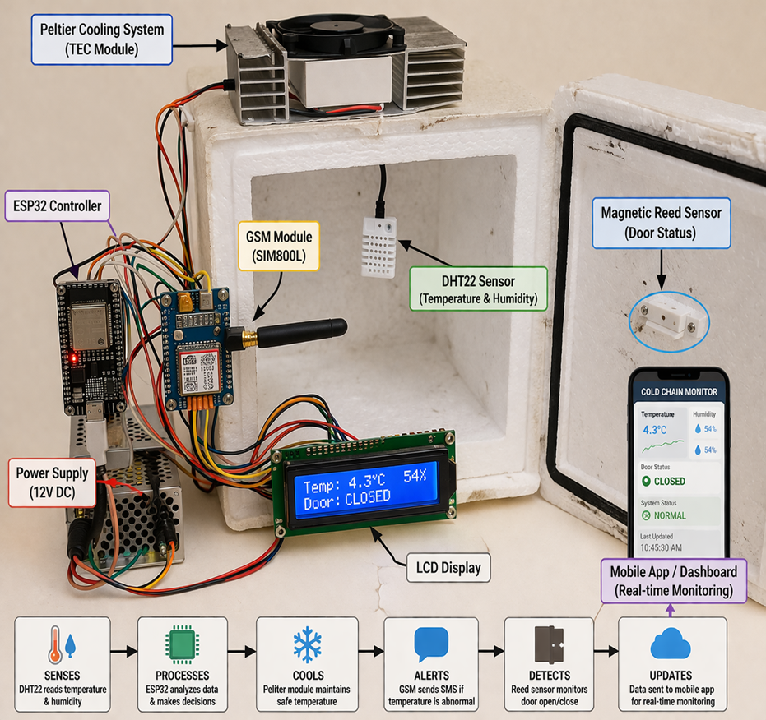

THE PROBLEM STATEMENT
Existing systems focus on monitoring, not prevention.
Lack of real-time humidity and airflow control causes produce spoilage.
Delayed response mechanisms lead to critical temperature rises.
High dependence on manual intervention and unreliable internet.

Slide 5






PROJECT OBJECTIVES
Smart Storage
Monitoring
Auto-Control
Alerting
Develop a robust system for safe storage of vaccines and fresh produce.
Continuous tracking of temperature, humidity, and airflow patterns.
Implement automatic failure prevention via closed-loop hardware logic.
Provide real-time GSM and IoT dashboard notifications for anomalies.

Slide 6
SYSTEM METHODOLOGY
Integration
Logic
Execution
Analytics
Validation
Sensor interfacing (DHT22, Reed, GSM) with ESP32.
Threshold comparison (2-8°C, ≤90% RH) in real-time.
Triggering Peltier cooling and backup buzzer/SMS.
Trend analysis via Blynk Cloud for predictive flagging.
Testing under simulated failure conditions.

Slide 7
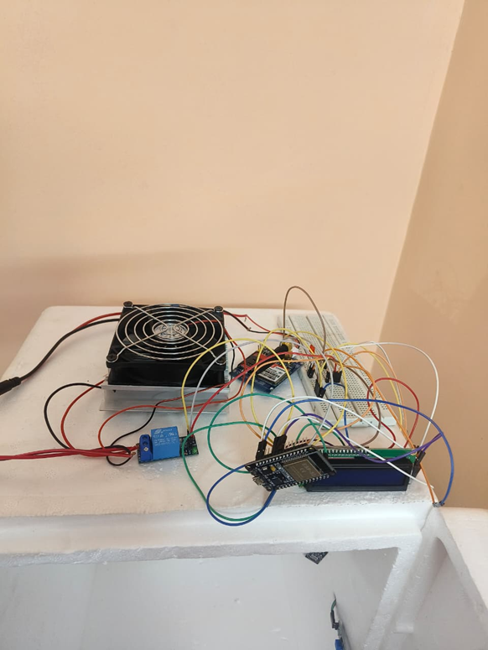

HARDWARE ARCHITECTURE
Key Components
ESP32: Central microcontroller for processing and MQTT.
DHT22: High-precision humidity and temperature sensing.
SIM900: GSM module for off-grid SMS alerting.
Peltier: Thermo-electric cooling for active temperature control.
Buck Converter: Voltage regulation for 12V battery packs.

Slide 8

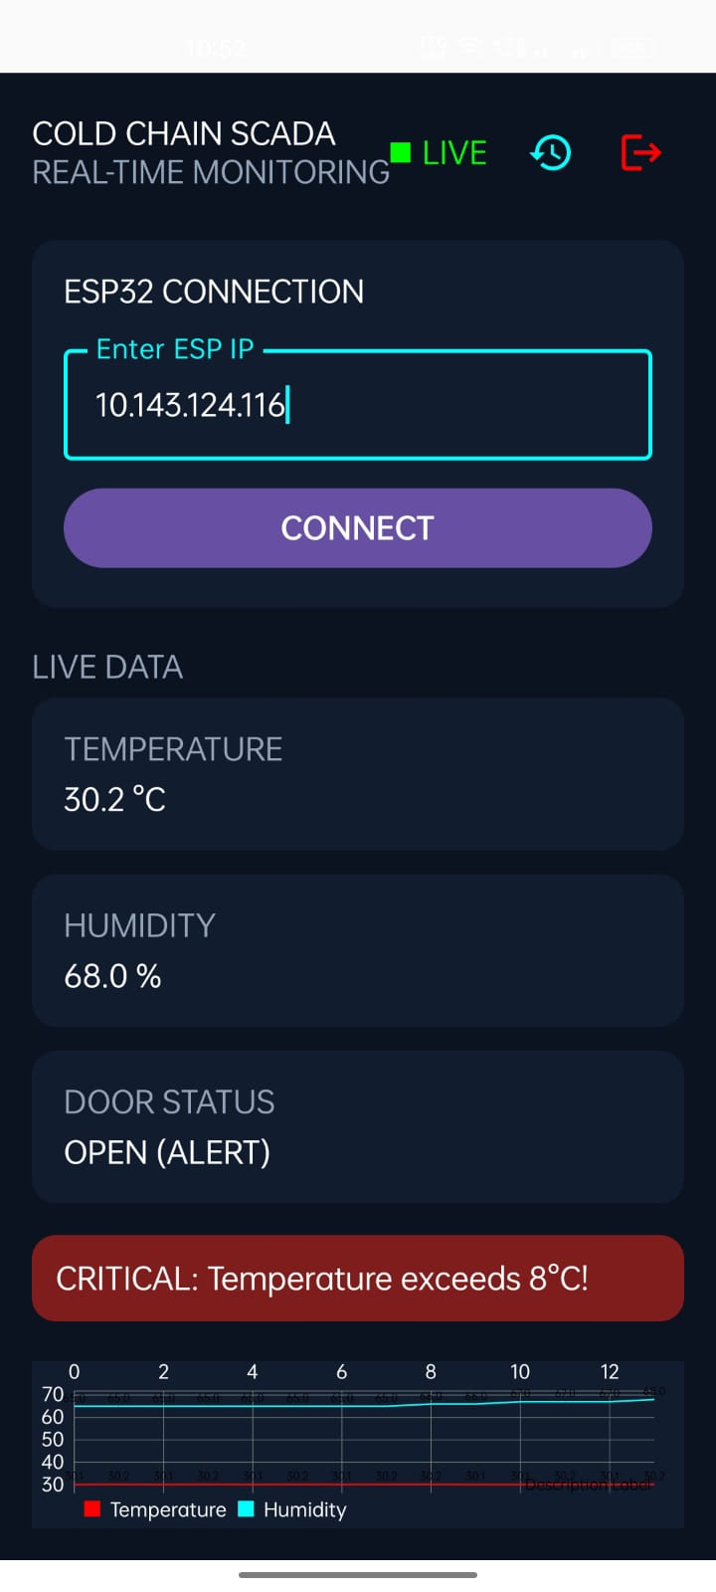

CUSTOM IOT APP
We have developed a bespoke mobile application specifically designed for the real-time visualization of cold chain parameters.
Secure Access & Monitoring
The app features a Secure Login Interface with real-time data sync via Blynk Cloud.
Temp Monitoring
Humidity Control
IoT Connected
Real-Time Alerts

Slide 9


CHALLENGES & MITIGATION
Harsh Environments
Network Reliability
Ensuring sensor accuracy in sub-zero conditions via robust calibration and shielded enclosures.
Implemented dual-channel alerts (Wi-Fi + GSM) to ensure uptime during infrastructure failures.
Energy Efficiency
Data Volume
Optimized cooling control logic to maximize 12V battery life during mobile transit.
Handling large telemetry streams for predictive analytics through edge filtering on ESP32.

Slide 10

EXPECTED OUTCOMES
99%
Project Impact
Full compliance with WHO storage norms.
Scalable solution for logistics companies.
Reliability in Real-Time Alerts
Transparent audit trails via cloud logging.
Drastic reduction in spoilage through proactive corrective actions and early flagging.
Proactive prevention vs Reactive monitoring.

Slide 11
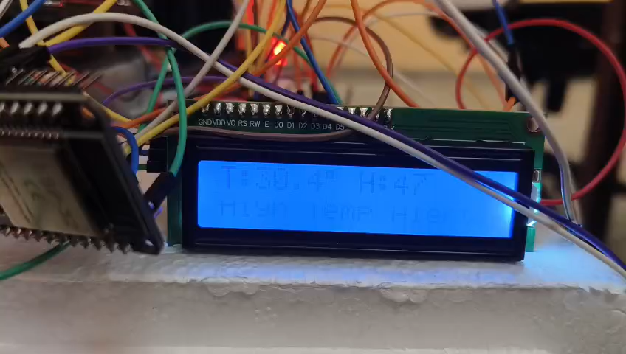

Slide 12
THANK YOU

